Slide 1
One Dimension
Finite Difference Time Domain
Assignment
R08945011
張祐祥

Slide 2
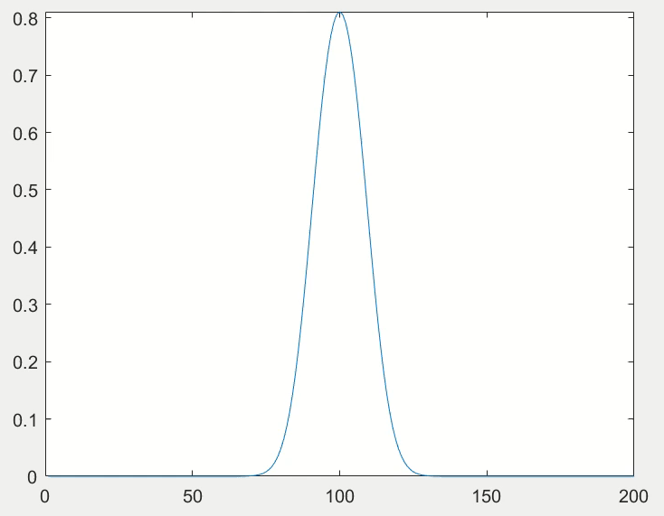
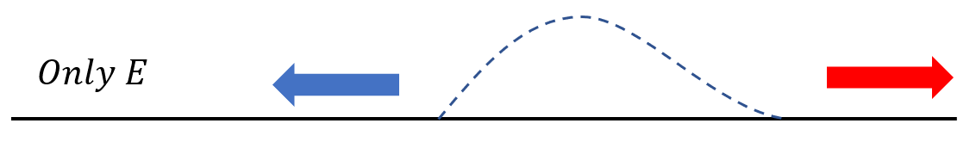

Slide 3
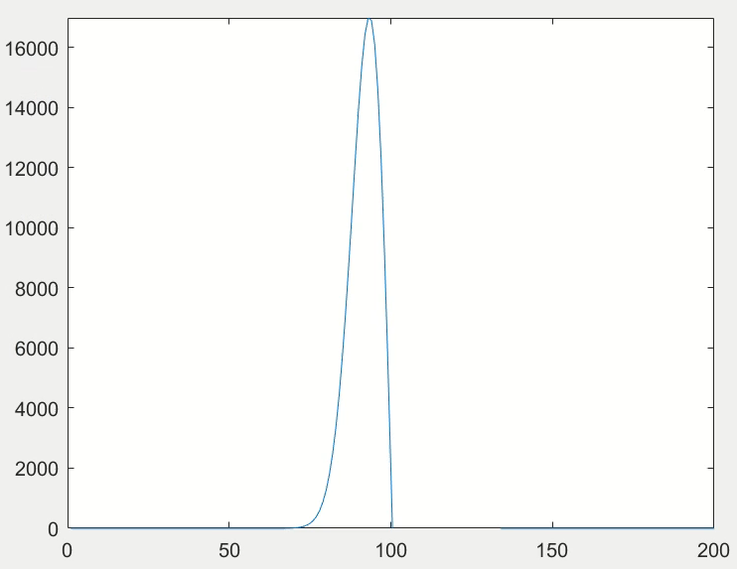
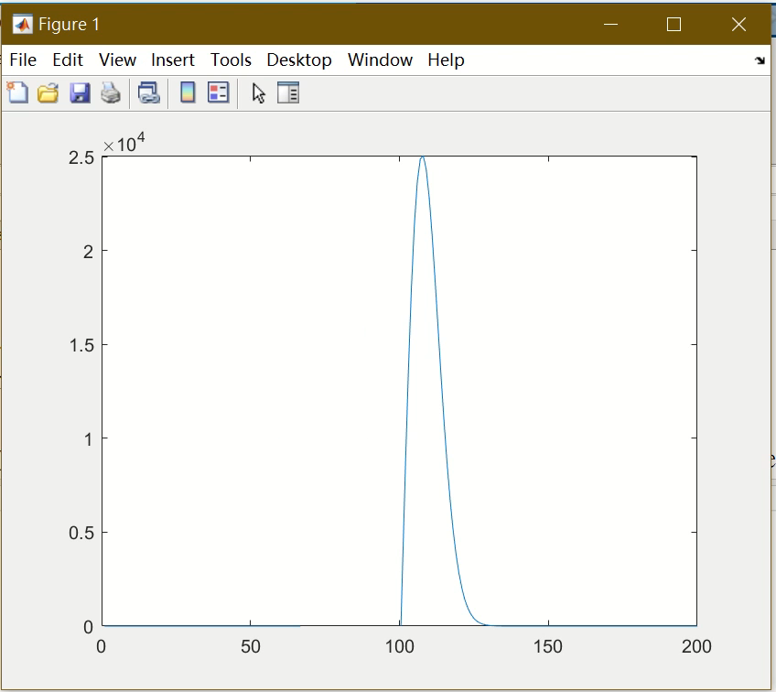
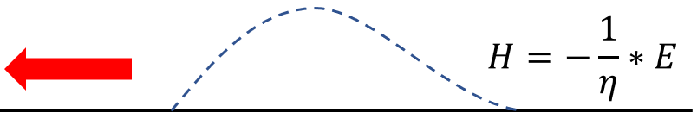
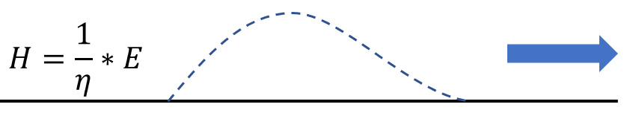
Hy = -(1/wave_imp)*Ex;
Hy = (1/wave_imp)*Ex;

